Slide 1
Section II: Wireless Location Technologies
Basic Positioning Methods
  Dead reckoning
  Proximity sensing: signal signature tracking
  Trilateration: signal strength analysis and TOA
  Multilateration: TDOA
  Triangulation: AOA
Satellite Positioning Systems
  Global Positioning System
  Galileo
  Assisted GPS
Positioning in 3G Networks
  Mobile-based technologies: Cell-ID, time advance,
  Network-based technologies: TDOA, AOA
  Mobile-assisted technologies: A-GPS, AFLT, OTD
All Rights Reserved, Shu Wang, 2009~2019

Slide 2
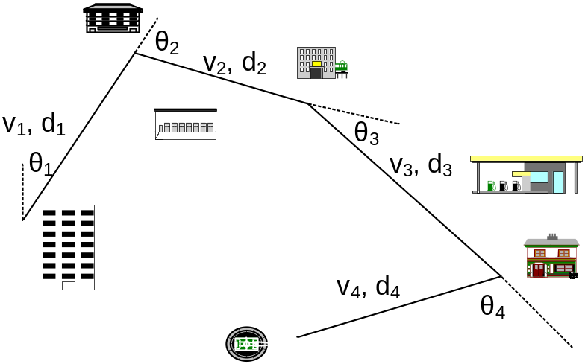
Dead Reckoning
Dead reckoning is the processing of estimating one’s current position based upon
  previously determined positions
  known speed and acceleration
  moving direction
  elapsed time
  traveled distance
  courses.
It is well known to be the method used by Christopher Columbus for discovering the New World and modern inertial navigation systems, for example, for marine navigation and air navigation.
All Rights Reserved, Shu Wang, 2009~2019

Slide 3
Proximity Sensing: Signal Signature
In the proximity sensing, the mobile position is derived from the base-station coordinates. It is usually determined by tracking signal signatures or cell identity (Cell ID) of neighboring base stations.
Every base station has its own signal pattern, which is usually embedded into its pilot and some synchronization channels.
Signal signature based technologies usually comprise
  signal signature estimation
  neighbor list update
  mobile location analysis
Traffic Pattern Theory.
  A person’s daily activity pattern is pretty regular, which comprises several major events, such as school, work, home and shopping.
All Rights Reserved, Shu Wang, 2009~2019

Slide 4
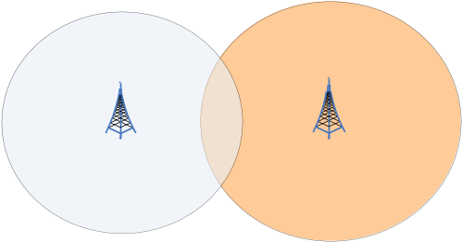
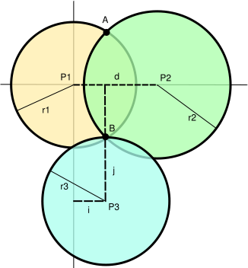
Trilateration
Trilateration: it determines the relative positions of objects using
  the known locations of two or more reference points, e.g. base stations.
  the measured distance between the mobile and each reference point.
Trilateration with signal strength analysis:
  the distance is proportional to its received signal strength,
  SS_{rx} = P_{tx} - 10αlog(d) + X (dB) .
Trilateration with time of arrival (TOA): the distance can be obtained by estimating TOA of received signals.
All Rights Reserved, Shu Wang, 2009~2019

Slide 5
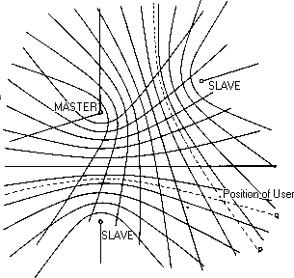
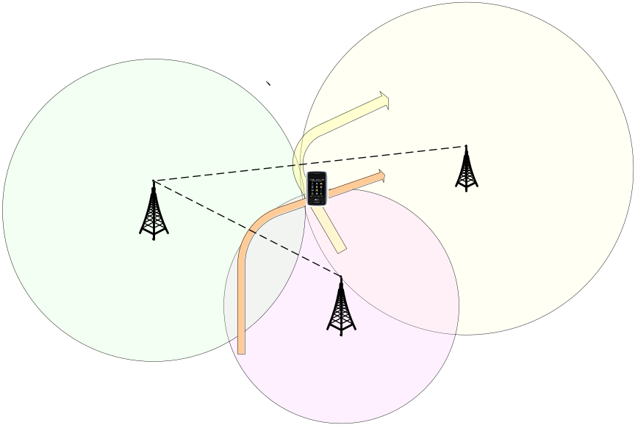
Multilateration: TDOA
Multilateration, also known as hyperbolic lateration, usually is the positioning process by estimating time difference of arrival (TDOA) of a signal.
TDOA method is similar to TOA estimation but doesn’t need a clock synchronization.
All Rights Reserved, Shu Wang, 2009~2019

Slide 6
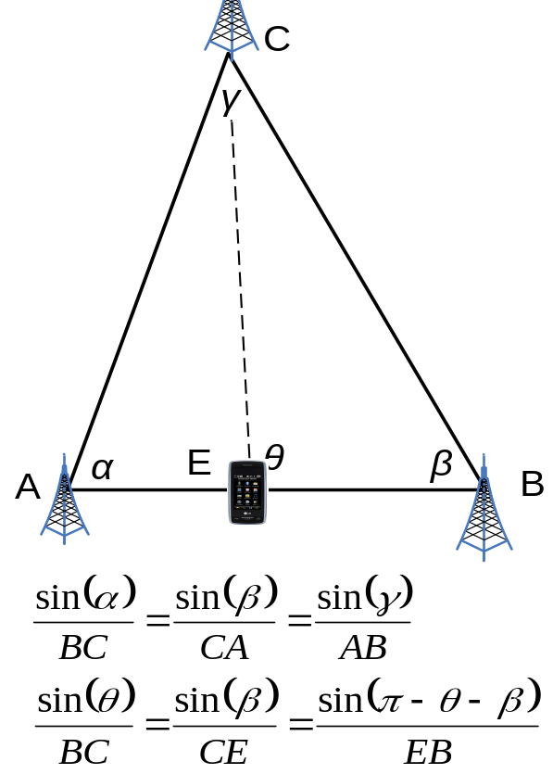
Triangulation: AOA
Triangulation is the process of positioning a mobile with measuring
  Angles of arrival (AOA) between the mobile and reference points, and
  sides of the mobile and reference points.
Triangulation is used for many purposes, including survey, navigation, astrometry, etc.
The AOA is usually determined by using multiple antennas at a base station
  The fundamentals are well established in the context of array signal processing.
Many schemes are developed for estimating AOA, such as
  Maximum output power,
  Maximum likelihood estimation,
  Subspace-based approaches.
All Rights Reserved, Shu Wang, 2009~2019

